Slide 1
Second Screen - From Mobile to the Lounge
Allan Pead
Xamarin Authorised Partner
@adpead / apead@adsoftsystems.co.za

Slide 2
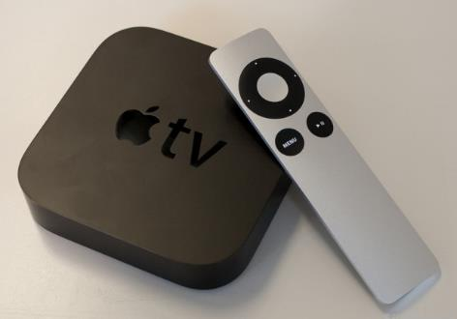


Apple TV
R 1,389

Slide 3






Apple TV
AirPlay, Mirroring
iTunes support (Music, Video)
Media Streaming
iCloud
Features

Slide 4
Apple TV
OS: iOS* (variant)
Hardware: Apple single-core A5 chip
HDMI
Bluetooth (for keyboard)
WIFI
Ethernet
Micro USB (for Support)
Remote
Specs

Slide 5
Apple TV
None
(no SDK for the general public)
Developer Options

Slide 6
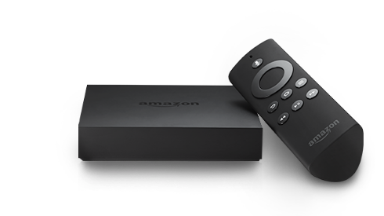

Amazon Fire TV
$ 99

Slide 7


Amazon Fire TV
Android Compatible
Multiplayer Gaming (supports 7 Gamepads)
Integration with Amazon Services
Voice control
FreeTime (parental control)
Second Screen Integration via DIAL (Discovery and Launch)
Features

Slide 8
Amazon Fire TV
OS: FireOS 3 (Android)
Hardware: 1.7GHz quad-core processor
2 Gig RAM
8 Gig Storage
Adreno 320 GPU
HDMI
WIFI
Ethernet
USB
Remote
Gamepad
Specs

Slide 9
Amazon Fire TV
Java (Eclipse, Android SDK)
Xamarin.Android
Amazon FireTV SDK Addon
Android 4.2.2 API 17
Developers site: https://developer.amazon.com/public/solutions/devices/fire-tv
Developer Options

Slide 10
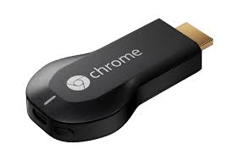

ChromeCast
R 599

Slide 11

ChomeCast
Media Streaming
Screen Mirroring
Cross Platform Mobile Device Integration
Low Cost
Features

Slide 12
ChomeCast
OS: Chrome* (derivative)
Hardware: Marvell DE3005-A1*
512 MB DDR3L SDRAM
2 Gig Storage
HDMI
WIFI
Micro USB (for Power)
Specs
Notes:
https://www.ifixit.com/Teardown/Chromecast+Teardown/16069

Slide 13
ChromeCast
Receiver Apps: JavaScript, Html, CSS
Sender Apps: Java Android SDK, Xamarin.Android
Objective C / Swift SDK, Xamarin.iOS
Chrome Sender SDK Html, JavaScript
Developers site: https://developers.google.com/cast/
Developer Options

Slide 14
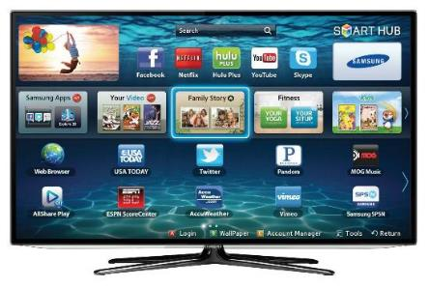


Samsung Smart TV
R 13,900
(Series 7)

Slide 15

Samsung Smart TV
TV with integrated processing in one package
Built in Motion Control, Voice Control, Camera (with Face Recognition)
3D Support
Media Streaming (All Share / DNLA)
Smart Hub
Features

Slide 16
Samsung Smart TV
OS: Linux 2.6
Resolution: App: 960 x 540 32 bpp
Smart Hub:1280 x 720 32 bpp
Video: 1920 x 1080 32 bpp
Hardware: QuadCore Processor
DDR3 memory (1.5GB) 4GB Flash Memory
WIFI
USB 2.0
Smart Remote
Camera
Microphone
Specs

Slide 17
Samsung Smart TV
JavaScript, CSS, HTML, FLASH*, supports NaCl
SDK Includes IDE and Emulator (Virtual Box)
SDK downloadable from http://www.samsungdforum.com/Devtools/SdkDownload
Smart TV design principles http://www.samsungdforum.com/UxGuide/2013/01_design_principles_for_creating_samsung_apps_content.html
Developer Options

Slide 18
ChromeCast
Mobile Device or Chrome
ChromeCast
Sender
Receiver
Architecture
Remote
TV or Second Screen Experience
Notes:
https://developers.google.com/cast/docs/chrome_sender
https://cast.google.com/publish/

Slide 19
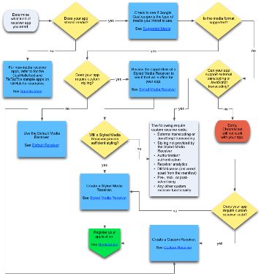
ChromeCast
Choosing a Receiver
https://developers.google.com/cast/docs/receiver_apps
Notes:
https://developers.google.com/cast/docs/chrome_sender
https://cast.google.com/publish/

Slide 20
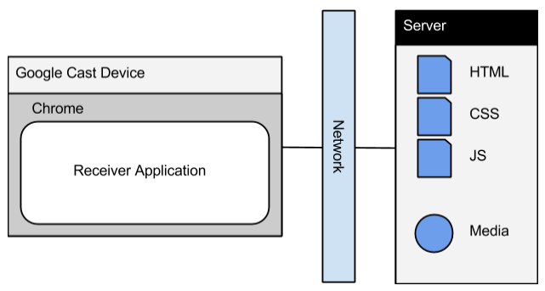
ChromeCast
Custom Receiver
Notes:
https://developers.google.com/cast/docs/chrome_sender
https://cast.google.com/publish/

Slide 21
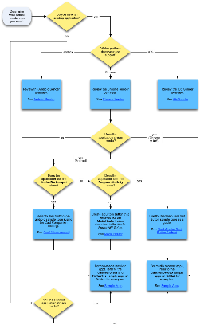
ChromeCast
Choosing a Sender
https://developers.google.com/cast/docs/sender_apps
Notes:
https://developers.google.com/cast/docs/chrome_sender
https://cast.google.com/publish/

Slide 22
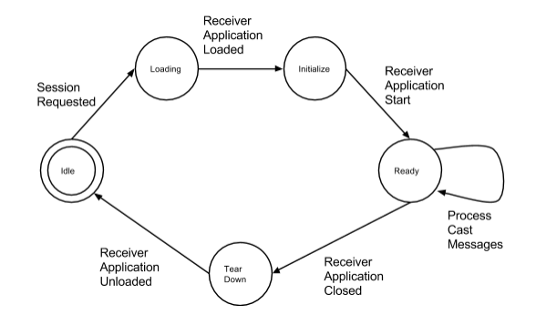
ChromeCast
Receiver Life Cycle
Notes:
https://developers.google.com/cast/docs/custom_receiver
https://cast.google.com/publish/
A receiver application may tear down (end its current life cycle) under the following conditions:
The receiver application gets a message from a connected sender to end the application session.
The receiver application has been idle for a defined period of time without any connected senders and decides to end the application session.
The receiver encounters a fatal error during its normal life cycle (rare but possible).

Slide 23
ChromeCast
https://cast.google.com/publish/
Registration
Notes:
https://developers.google.com/cast/docs/chrome_sender
https://cast.google.com/publish/

Slide 24
ChromeCast
http://[CAST IP ADDRESS]:9222/
Debugging Custom Receiver
Notes:
https://developers.google.com/cast/docs/chrome_sender
https://cast.google.com/publish/

Slide 25
ChromeCast
Your Sender App is the Remote. All interactions are via the Sender.
ChromeCast is a low power device. Receiver should be as lightweight as possible for a smooth experience
UX Design Guidelines
General

Slide 26
ChromeCast
Should not look “touchable”. Keep User Interaction elements for Sender App.
Action is in centre of screen. Keep any UI elements to lower third
Use Transparency to make UI less apparent
UX Design Guidelines
Receiver

Slide 27
ChromeCast
Sender is for actions. Receiver displays state (eg. if content is paused, the TV should indicate that it is paused, while the mobile device indicates it is ready to start playing (e.g. showing the user a play button).
Adhere to Cast Icon guidelines
UX Design Guidelines
Sender

Slide 28
ChromeCast
https://developers.google.com/cast/docs/design_checklist
UX Design Guidelines

Slide 29
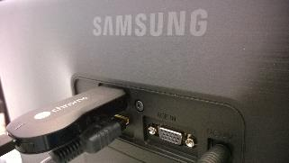
ChromeCast
Live Demo
Building an App
Notes:
Custom Receiver with Xamarin Sender
Styled Receiver with Xamarin Sender

Slide 30
Android on TV
Interaction is via a remote control.
Honour viewing distances
Simple navigation. (Avoid nesting)
Consistency across TV paradigms. (Eg. Play, pause rewind icons)
Provide clear feedback on controls. Ie Make control focus apparent.
Respond quickly
UX Design Principles
Notes:
https://developers.google.com/cast/docs/chrome_sender
https://cast.google.com/publish/

Slide 31
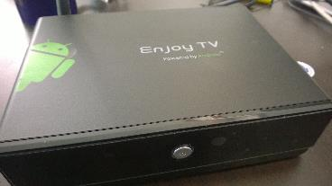
Android on TV
Quick Live DEMO
Building an App
Notes:
Xamarin Android TV Demo
Wifi Debugging
On Device: su setprop service.adb.tcp.port 5555
stop adbd
start adbd
Revert to USB: setprop service.adb.tcp.port -1
stop adbd
start adbd
On PC: adb tcpip 5555
adb connect [Device IP]:5555

